Slide 1
Version Control
Chris Winikka
TechStart Spring Conference 2013

Slide 2
You Probably Already Do It
Have you ever copied a folder as backup (just in case)?
Have you ever saved a folder with a new title?
From "My Project" to "My Project V. 2“
Has anyone ever done or currently use…
CVS?
Subversion?
Mercurial?
Git?
Something else?

Slide 3
What is Version Control?
Version Control is a System or Methodology to…
track progress in a project
manage group projects
manage a codebase
With all of its versions
encourage collaboration
track and resolve issues in a project

Slide 4
Some Examples
A current Web Development Project of Mine: BleedingThorn
Student Codebase Project: OurFinestHour
Note: these are all a private repositories
The next few slides are screenshots as demonstrations
For the live presentation, skip to the next part: More Benefits

Slide 5
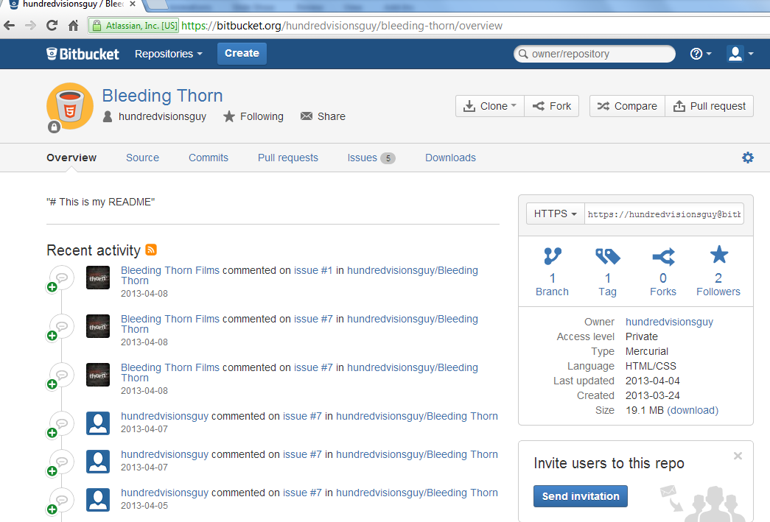
Bleeding Thorn: Overview

Slide 6
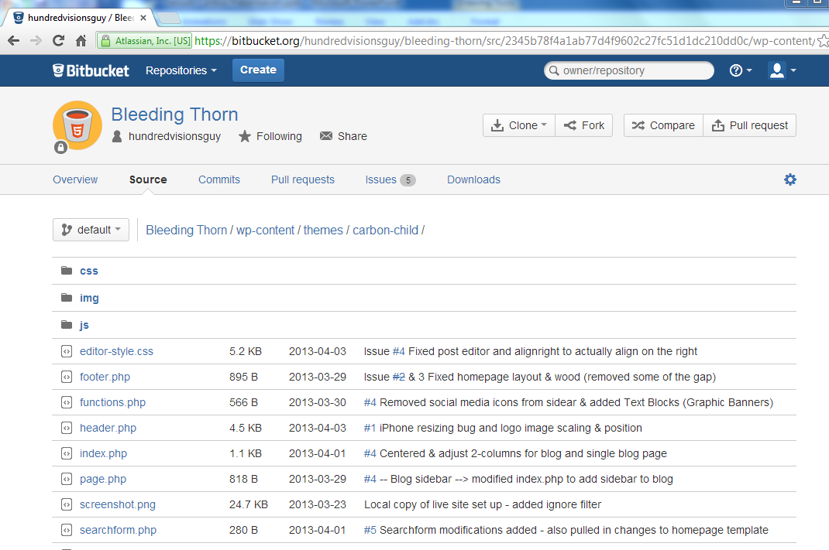
Bleeding Thorn: Codebase (source)

Slide 7

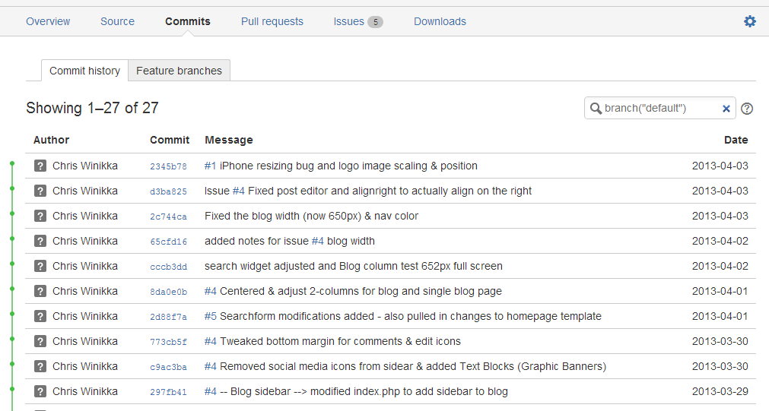
Bleeding Thorn: Commits (History)

Slide 8
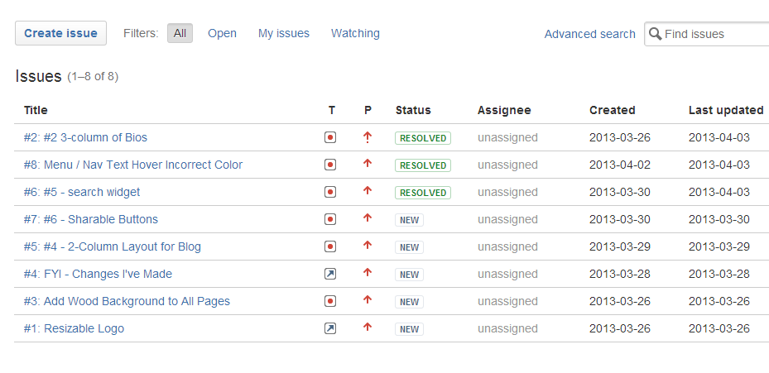
Bleeding Thorn: Issue Tracker

Slide 9
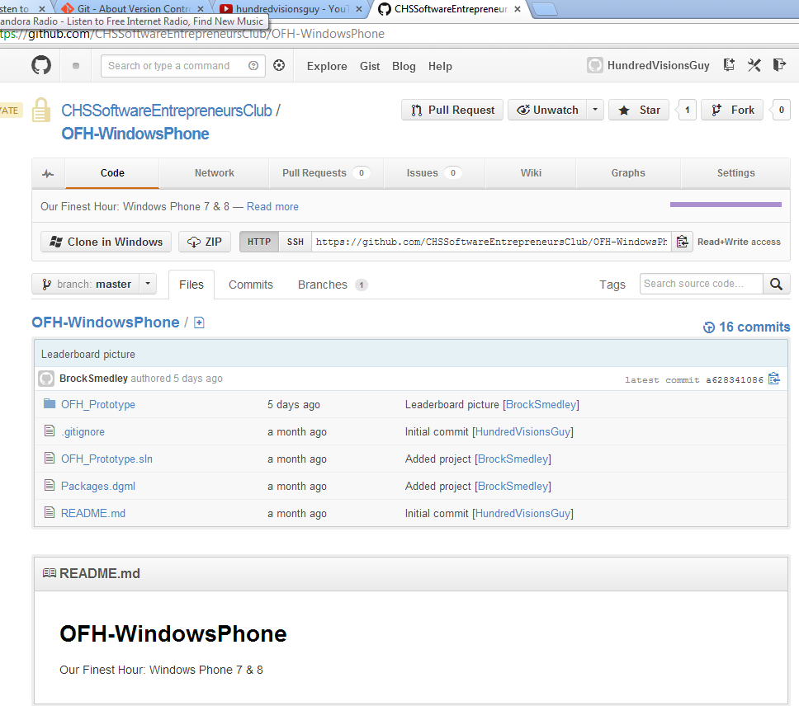
Our Finest Hour: Main Page

Slide 10
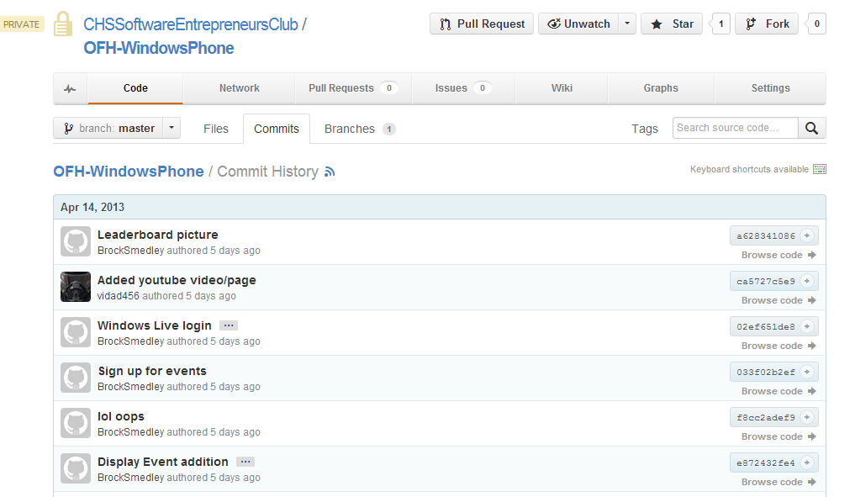
Our Finest Hour: Commit History

Slide 11
What are the Benefits?
It’s a personal project tracker
Anything you commit and push is preserved
Think of it as a snapshot of your project
Once you get to a stopping point, commit it
You can roll back at any point
You can branch off and make new projects off of any commit
Great for managing different versions (beta, 1.0, 2.0, etc.)

Slide 12
More Benefits
It’s a great collaboration tool
Many students can work on the same project
Each on their own computer
Works great with multiple files
Works great with 1 file (and clear communication)
Individuals or groups can work with a client/s

Slide 13
Even More Benefits
Online hosts have free (or for pay) online repositories
It’s cloud backup
You now have access to your project from anywhere
The big online hosts also include…
wikis for documentation
Issue trackers for project management or working with a client

Slide 14
How do you use it? 1,000ft. level
Create a new repository
or clone an existing one
Clone the repository
Pull any new changes to your clone
Merge changes with your project (if necessary)
Work on your clone
Commit Your Changes
Push Your Changes to The Repository
Notes:
The clone is your working copy
Each collaborator clones their own copy
Clone to any device that you plan to work on
I didn’t include here that you might wish to revert back
From the creation of a repository to the completion of a project, you’ll be jumping back and forth

Slide 15
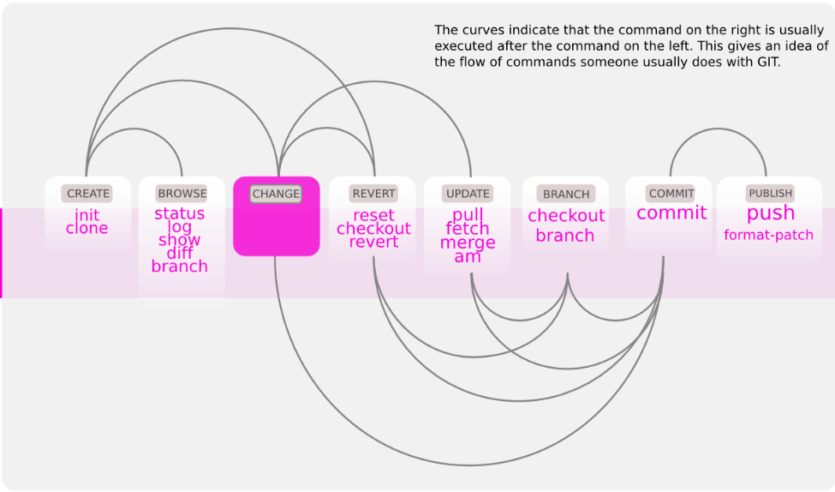
A Visual of the Work Flow
from Software Configuration Management www.markus-gattol.name

Slide 16
General Advice: Team Projects
Pull before you work
Merge if you need to
Commit every time you’re at a stopping point
Don’t break the build!!!
Pull after you work
Push your latest commit whenever you…
resolve an issue
add a feature
Notes:
Make sure you always pull and merge just before pushing

Slide 17
General Advice: Personal Projects
Use the issue tracker to set goals
And check them off when you’re done
Commit often
Push at the end of every work session
You never know when you may wish to work on it next

Slide 18
Ignore Filters
With some compiled languages, there are files we want to ignore
Visual Studio, for example, generates files we don’t need to track
GitHub covers that for their repositories
Stack Overflow.com can pick up any slack

Slide 19
Let’s Try it with Mercurial
Get Started:
Create a local repository
Ctr + N
Create a Clone to work with
Either clone your local repo
or clone an online repo
I add “Clone” to my cloned folder to make it easier to remember

Slide 20
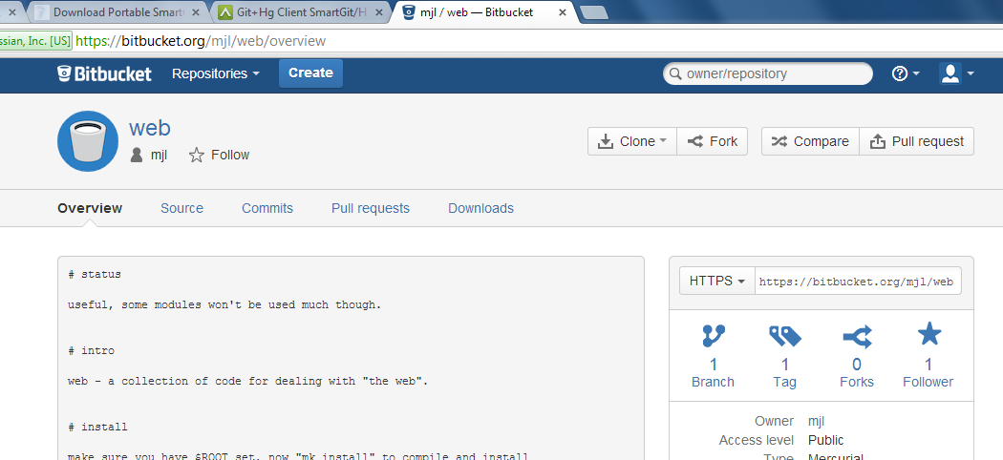
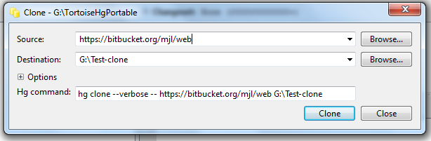
Let’s Try it with Mercurial

Slide 21
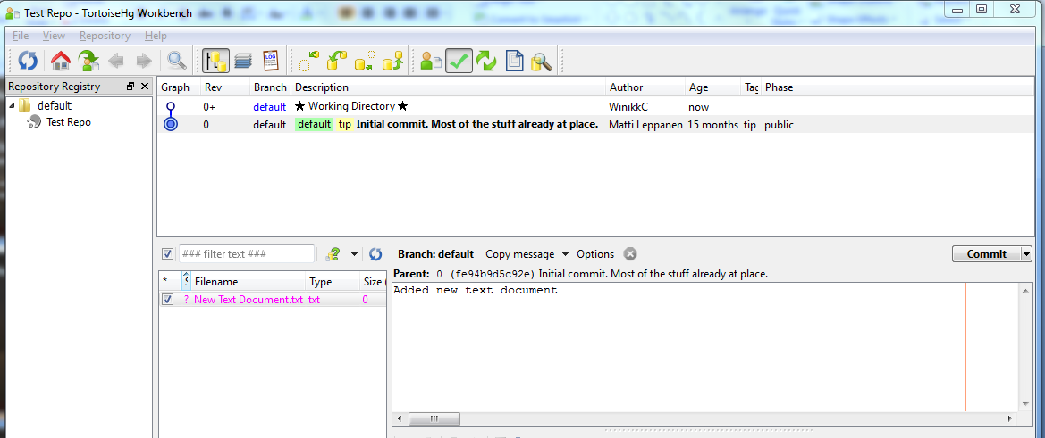
Mercurial: Your First Commit
Add a new file (README.txt) to your clone folder
Commit Your Changes
Open Workbench & click the green Check Mark
Check the box next to the new file
Add a commit message
Click Commit

Slide 22
Mercurial: For More Info
The rest of this workshop will be using Git
If you are interested in more on Mercurial…
Check out my Video Tutorials on YouTube.

Slide 23
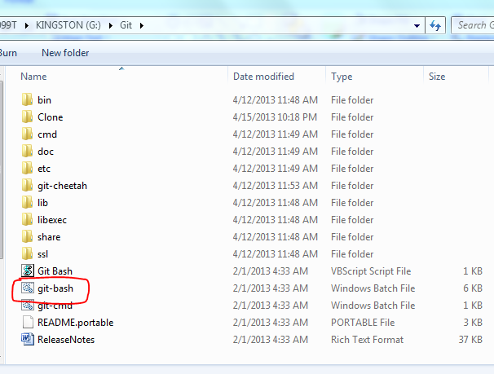
Let’s Try it With Git
We’re going to use Git-Bash
That’s command line
scary, huh?
Open the Git folder
Double-click “Git-Bash”
Don’t panic!

Slide 24
Git Setup (w/Git-Bash)
You probably want to create an account on GitHub first
Add your username
Use your GitHub username
$ git config --global user.name “FirstName LastName”
Add your email
Use your GitHub email
$ git config --global user.email UserEmailAddress
This is so
you can have direct access to the Git Repository
we can blame you if you break the build

Slide 25
Our First Git Clone
In Git-Bash, switch directories
$ cd G:/SCM
cd = change directory
Create a directory for your clone
$ mkdir ‘TechStartClone’
Navigate to the Clone
$ cd G:/SCM/TechStartClone
Initialize your Folder
$ git init
Clone the TechStart Repository
$ git clone https://github.com/HundredVisionsGuy/techstart-spring-conference.git
Notes:
When I was testing this, I first cloned, then initialized

Slide 26
Stage Our Changes
First, let’s make sure we can work on the real repository (not just your fork)
This is called upstream
$ git remote add upstream https://github.com/HundredVisionsGuy/techstart-spring-conference.git
Work in the clone and add a file &/or directory
Add all new changes (new files, directories, modifications, & deletions)
$ git add -A

Slide 27
Commit Our Changes
Note: you must include a note for your changes, so you and others will know what you did
$ git commit FileName –m “Message Text”
commits changes to the specified file and includes a message
$ git commit –a –m “Message Text”
commits all changes with a message

Slide 28
Push Our Changes Through
Pull any changes in first
$ git pull https://github.com/HundredVisionsGuy/techstart-spring-conference
Add all new changes & commit
$ git add -A
$ git commit –a –m “commit message”
Now, push through
$ git push
NOTE: you’ll need to enter your username and password for the GitHub repository

Slide 29
If You Never Want to Do Command Line Again
Download a GUI client for your computer
GitHub for Windows
GitHub for Mac
GitHub Mobile
Git – Downloads (comes with a simple GUI)
More GUI Clients

Slide 30
For More Information
Basic Git Command Line Reference for Windows Users
GitHub Bootcamp
BitBucket 101 – covers both Mercurial and Git
Git Basics
Pro Git – complete online (and free) book all about Git

